Slide 1
Generating Summary for Terms and Conditions Document Based on the Query provided.
Sai Teja Paladi
Email: spaladi@email.sc.edu

Slide 2
Overview
● Objective
● Introduction
● Problem
● Approach
● Evaluation
● Conclusion
● References

Slide 3
Objective
We introduce a system for summary generation based on the terms of service documents we usually agree to by reading the entire or useful content.
To have a system that can summarize the piece of information that you are worried about in a large document and get the important sentences?
Our system takes the URL of these terms and conditions documents and the query we are concerned about as the input and produces the summarized sentences.
Notes:
Tuned to match the composition, bias, and media consumption patterns of a specific target audience
Software agents infused with human-like decision parameters
Incorporates both traditional and social media influence
Live subjects incorporated with agents enhance realism
Player units and experimenters inject new information and observe both the spread of information and the changes in the network topology
Free-thinking and adaptive opposing forces accurately reflect current threats and near-peer competitors

Slide 4
Introduction
Usually when we come across the terms and conditions documents most of the users just simply click on agree button and move on rather than reading the entire document.
And some people might search for some points like is their data is confidential or not.
And to make sure the user get’s the data that he’s concerned about and also in a simple summary we are fetching the data based on the user interest and summarizing it.
If we do so we don’t need to worry about reading the entire document or missing any important points.

Slide 5
Problem
Summarization Tool
In our system we have two inputs one is the document that we are currently dealing with In our project we are summarizing the terms and conditions documents which mainly talks about the privacy of the data.
And based on the provided input document and the area of interest we will be fetching out the sentences that provide the useful information.
Summarization Tool
Summary
URL

Slide 6
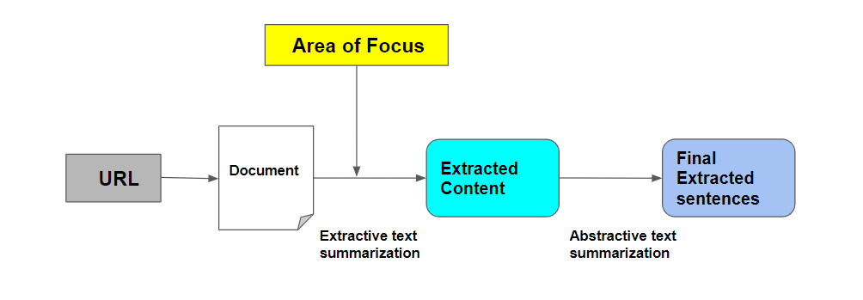
Approach
In our problem we cannot directly perform the text summarization to get the sentences based on the area of focus we have to first get the relevant data or passages from the long documents that we use as an input based on the area of focus that we provide and ask for.

Slide 7
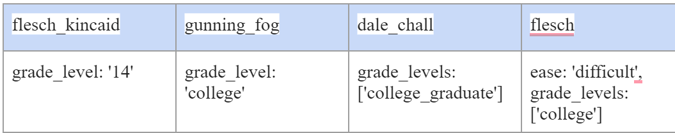
Approach
Readibility metrics
Before getting into the actual data pre processing and summarization. We are using some readability metrics to the raw data in the document. These readability metrics helps us to understand the ease of how a user can read the actual document. It depends on the content in the document and the size of the document.
Here are some results of four types of readability metrics that we used to evaluate the document.
We can clearly observe that for each readability metric here the level of difficulty is above the grad level which is difficult to read.

Slide 8
Approach
Text summarization is mainly divided into two categories
Extractive Summarization
The extractive text summarization methods rely on extracting sentences and phrases from the documents and creating summary. Identifying the correct sentences for summarization is an important task in this method.
Abstractive Summarization.
The abstractive text summarization methods use advanced NLP techniques to generate an entirely new summary. Some parts of the summary will not even appear in the original text.
Extractive Summarization
In our project, we will first generate the important sentences based on the extractive text summarization that we perform on our documents, and then we will rank the sentences based on the query that we are looking for in summary. We will use the TextRank algorithm on the data we extract from the URLs and create a brief summary based on the provided content.

Slide 9
Approach
Steps in Extractive Summarization
Parsing the HTML content from the URL that we have provided as an input. We create a .txt document based on the parsed data.
We will split the text into into individual sentences. We will use the senttokenize( ) function of the nltk library to do this.
We download GloVe Word Embeddings to create features for our sentences
We perform text cleaning by removing the punctuations, numbers and special characters. We will also get rid of the stopwords(is, am, the, of, in, etc) by dowloading nltk-stopwords and defining a function to remove the stop words.
And finally we use the sentences to create vectors for sentences in our data using the GloVe word vectors

Slide 10
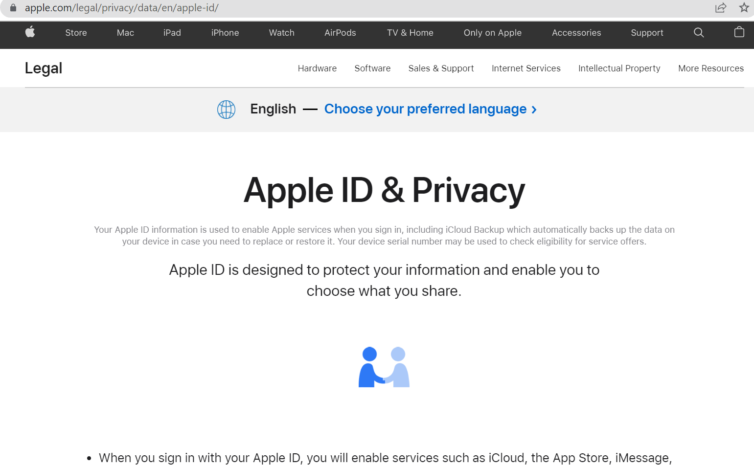
Evaluation
Our main aim is to generate summarized sentences based on the query that we provide.
For Example, if a user wants to know about the data he is sharing with the company. Using our model, we can provide the query as Data Security and fetch the top extracted summarized sentences

Slide 11
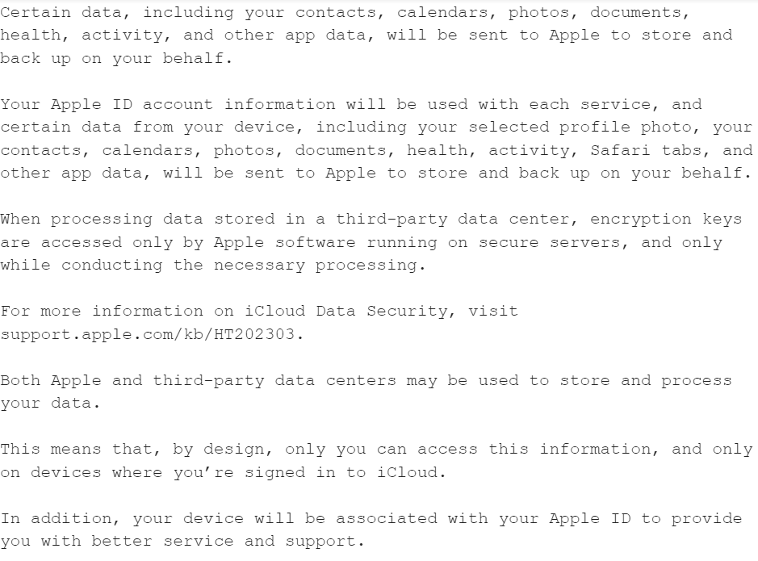
Evaluation
As shown in the figure below, all the top extracted sentences involved in data security are listed concisely. A user can go through these sentences to learn about his data privacy and security rather than the entire document.

Slide 12
Conclusion
Summarization provides the user with a small amount of important data that he’s concerned about when reading or agreeing to a large amount of data or secured documents. Which may involve his confidential data. Using this query-based summary, we can get the required data and in a short format.

Slide 13
References
Moratanch N, Gopalan C (2017) A survey on extractive text summarization. pp 1–6
Rahim Khan, Yurong Qian, Sajid Naeem. Extractive based Text Summarization Using K-Means and TF-IDF, International Journal of Information Engineering and Electronic Business, May 2019
PL.Prabha, M.Parvathy. Extractive and Abstractive Text Summarization Techniques, Inter-national Journal of Recent Technology and Engineering (IJRTE) ISSN: 2277-3878, Volume-9 Issue-1, May 2020.
https://www.sciencedirect.com/science/article/abs/pii/S0885230820300991
https://blog.agolo.com/query-based-summarization-in-action-ea729df3109c
https://ieeexplore.ieee.org/document/7557434

